Slide 1
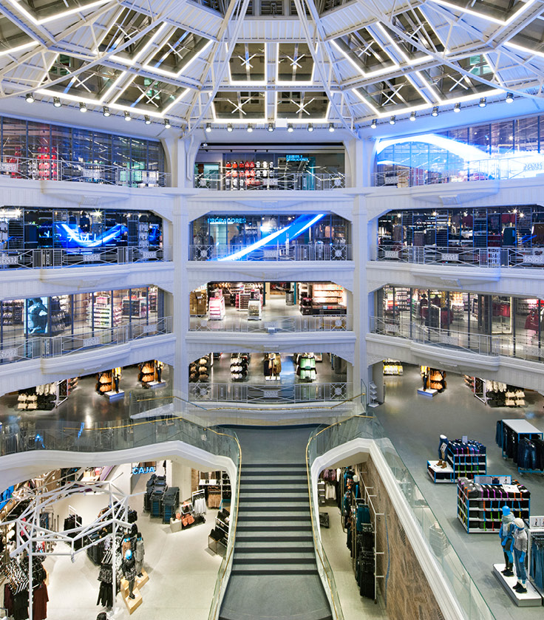
Centralised Clearance
Primark’s Journey

Slide 2
Why does Primark Exist?
We’re here to create
maximum joy at
minimum cost

Slide 3

Our History
1973
Primark Lands in the UK
The store opening marks a new era outside of Ireland and a new name, rebranding Primark as it is known as and loved for today.
2006
Primark Expands in Europe Primark opens stores in Spain, The Netherlands, Portugal, Germany, Belgium, Austria, France and Italy.
2013
Primark Launches its Sustainable Cotton Program Primark set itself a challenge; change the way it sources its cotton, protect the planet and support farmer livelihoods. Primark’s Sustainable Cotton Program was born. Today it’s the largest of its kind of any single fashion retailer with 275k farmers involved in the program by 2023.
1969
First Store Opens
Launch in Dublin, Ireland as Penneys, the idea of ‘amazing fashion at amazing’ prices is born.
2022 - 2024
We continue to expand Entering new markets, including Slovakia, Romania and Hungary.
2015
America ♥ Primark
Primark opens its first doors in the United States in Boston, Massachusetts and begins its expansion across the country.
2021
Sustainable Fashion for Everyone
Primark announces Primark Cares, a wide-reaching sustainability strategy, designed to reduce fashion waste, halve carbon emissions across its value chain and improve the lives of people who make Primark products.
2020
Primark Accelerates US Growth
After success in its Northeast locations, Primark continues expansion to new states and opens stores in Florida & Chicago.

Slide 4
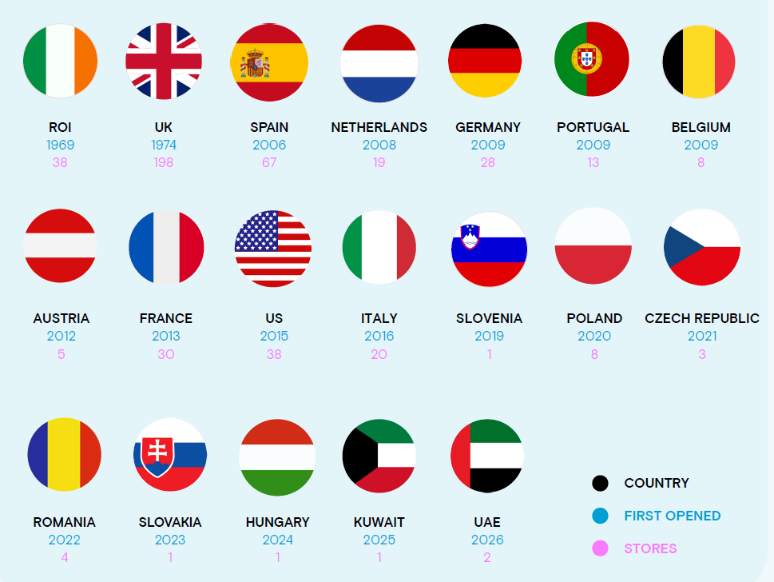
Our global footprint

Slide 5





How do we keep our prices so low?
JOGGER
MADE USING RECYCLED
DRESSES
MADE USING SUSTAINABLE COTTON
POLYESTER
11/2-8 YEARS
€ 14
€ 4
We sell a lot of items, which means we’re able to make savings from buying in bulk for all our stores.
We create clothes that offer the latest trends but we don’t use expensive hangers, tags or labels.
We also try to be as efficient as possible when transporting products from factories to stores. This includes things like asking suppliers to pack our t-shirts so they are ready to go straight on the shelf.
We work with ambassadors and influences and are less reliant on traditional marketing such as advertising.
SLIM FIT T-SHIRT
MADE USING SUSTAINABLE COTTON
POLO SHIRT
7-15 YEARS
_{€ 4}.50
€ 8

Slide 6
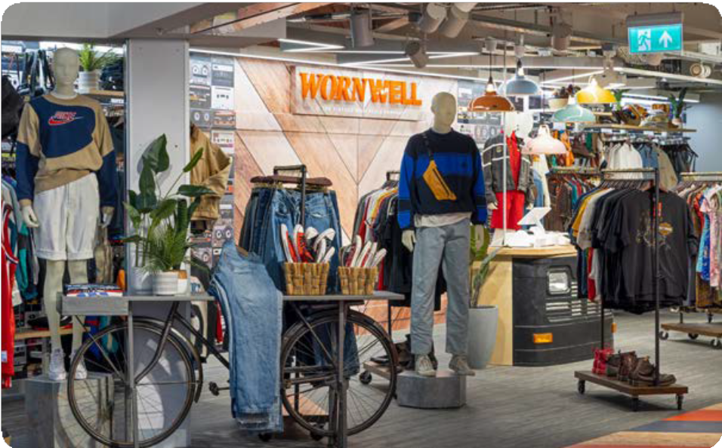

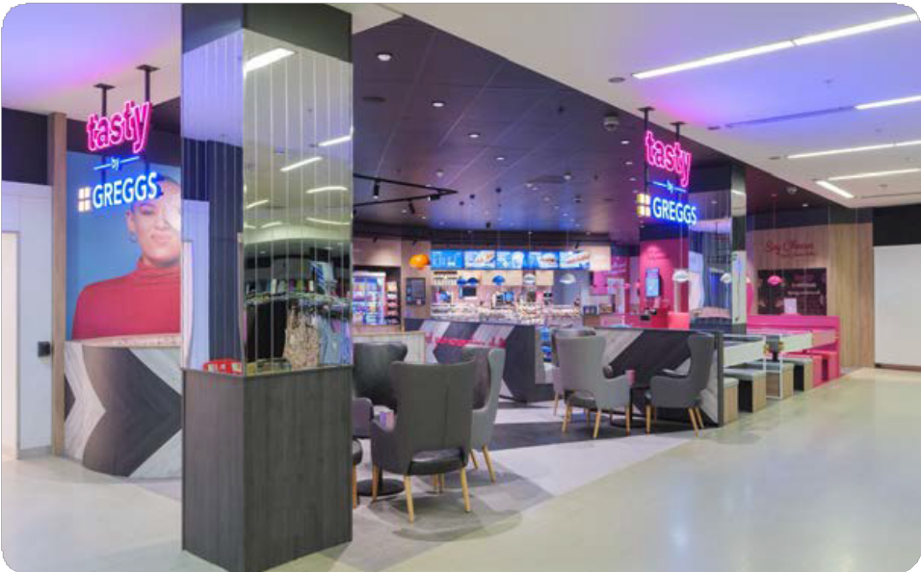
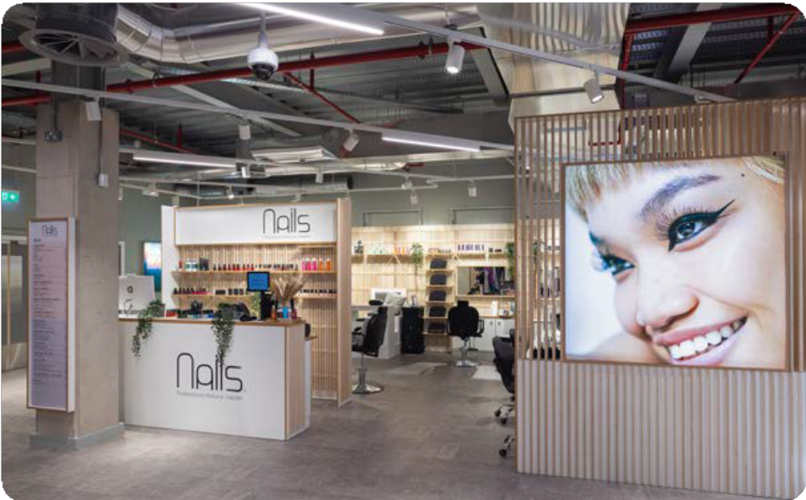
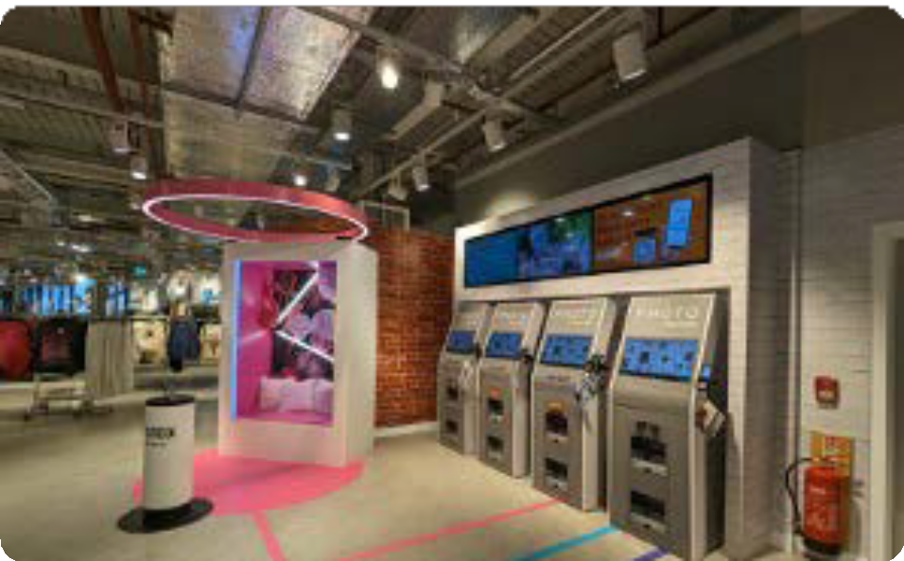
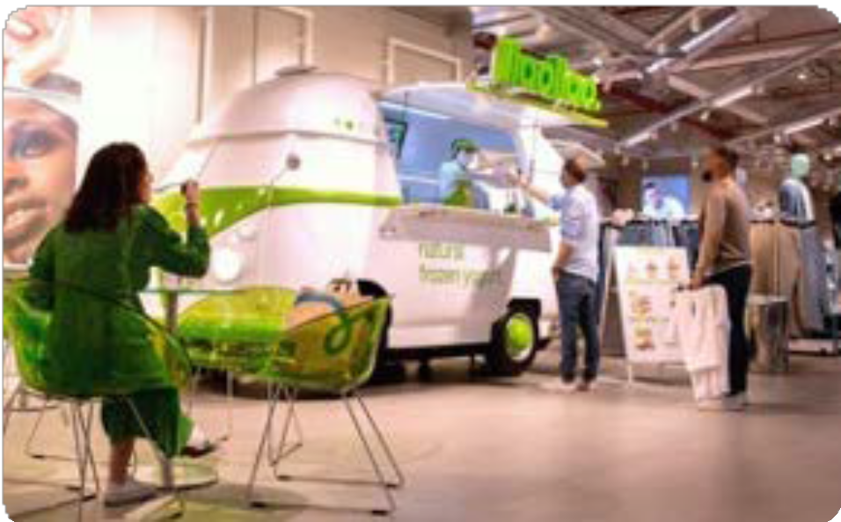
Our in-store experience

Slide 7

Our journey to Centralised Clearance
10
Import/export processors
Plotting a course from SASP to CCI and beyond
Primark utilises SASP under CCC rules.
The desire to authorise under Centralised Clearance rules has been present since the introduction of the UCC.
We currently have an
arrangement with
Ireland (supervising)
and The Netherlands
(participating)
We want to add more
participating MSs
(Germany, Czech, Italy,
Spain)
and control more
activity through Ireland
114,659
SASP Customs declarations
€98.1m
SASP Customs duty paid

Slide 8
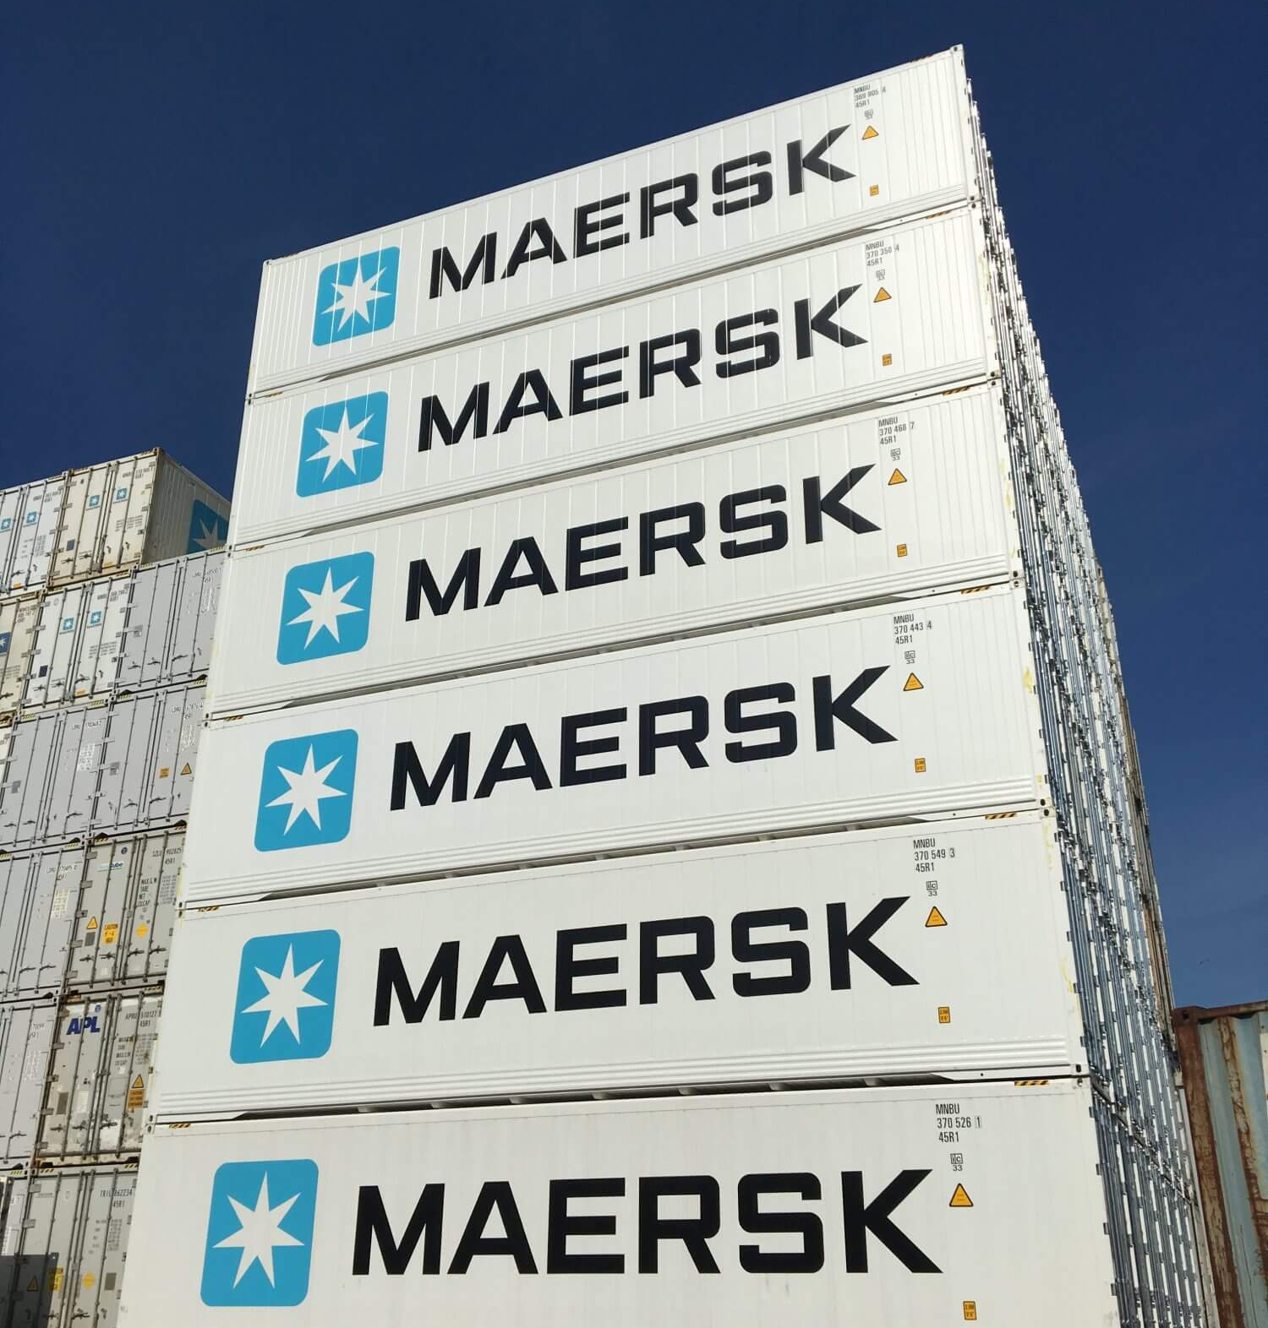
Primark’s centralised clearance plan
Our journey.
We intend to use centralised clearance extensively
Our application for export has been accepted and is subject to the authorisation being granted. We will begin with Germany, then will extend to other member states including the Netherlands, Czechia, and Italy.
For import, we are waiting for systems to be ready for our application to be submitted. We plan to apply for the same member states as the export authorization but will start with the Netherlands and extend to the other Member States when national infrastructure becomes available.

Slide 9
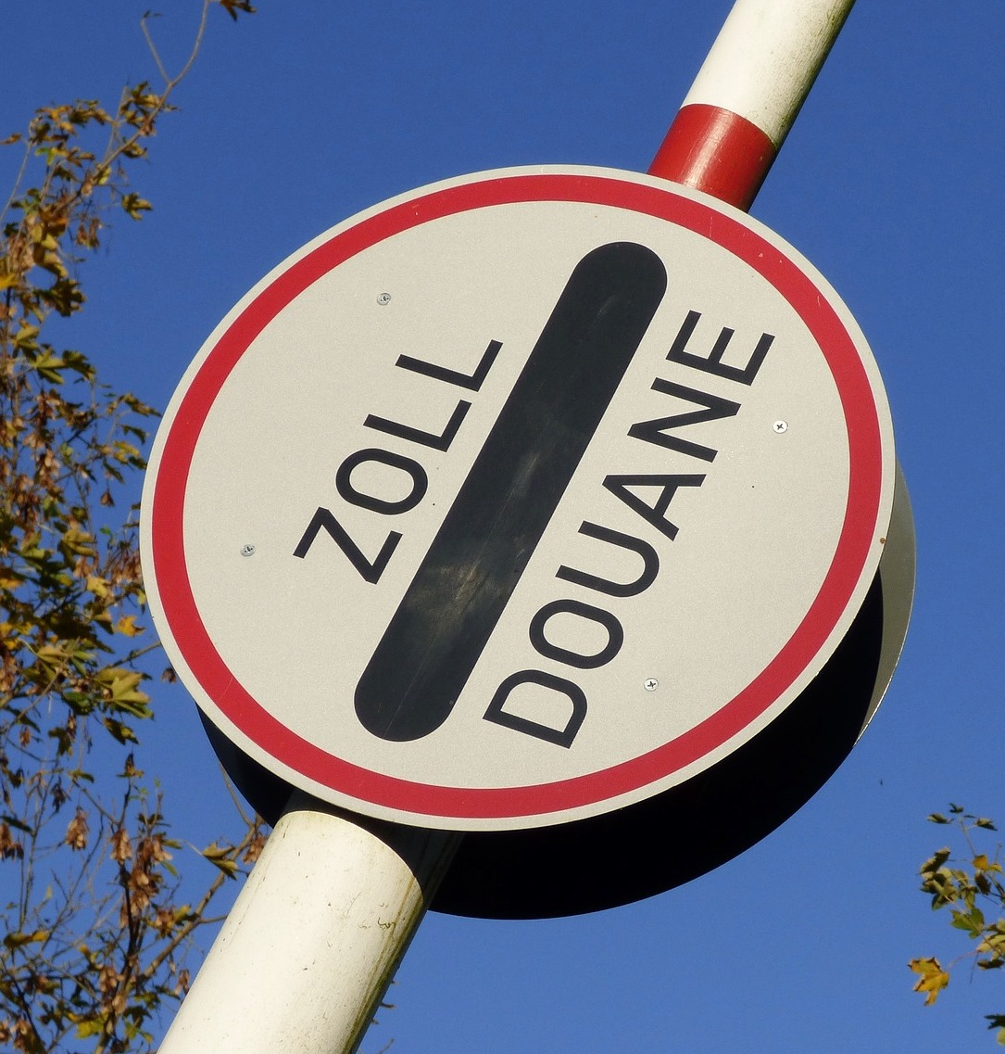
Barriers to centralised clearance implementation
Some of the blockers to success
We are waiting for national infrastructure to be ready but for import, there is not one member state that is ready for us.
The message provided by the Member States doesn’t necessarily match reality. Public timelines may differ.
Other authorisations may be required to allow us to import into those member states which are the competence of the member states (e.g. Transit and temporary storage.) This adds additional cost and complexity.
Some member states have become less facilitative – for example, removal of presentation waivers and I2 declaration requirements.

Slide 10
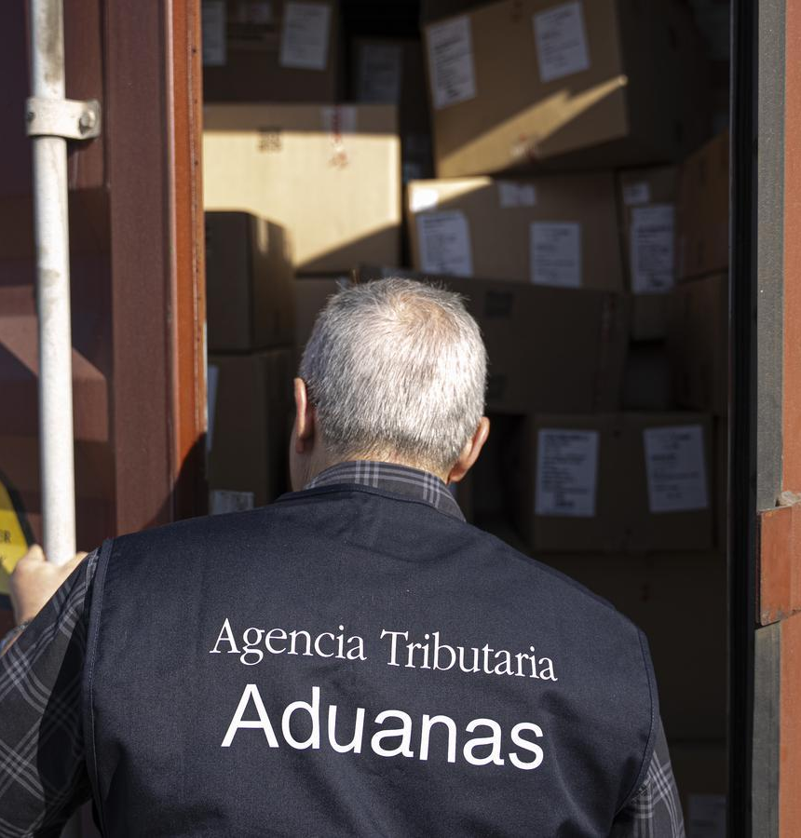
CCI – Evolution under the UCC
UCC reform and the impact on CCI
The recast UCC allows centralised clearance to continue until the implementation of the Customs data hub.
In the explanatory notes to the recast UCC, it correctly stated the benefits of centralised clearance are “yet to be realised.”
The recast UCC will remove centralised clearance on 1 March 2032.
Questions
What if the Data Hub is not ready?
How will we engage with the data hub? Directly or through national infrastructure?
How will the data hub work in member states that apply non-standard controls at the border?

Slide 11
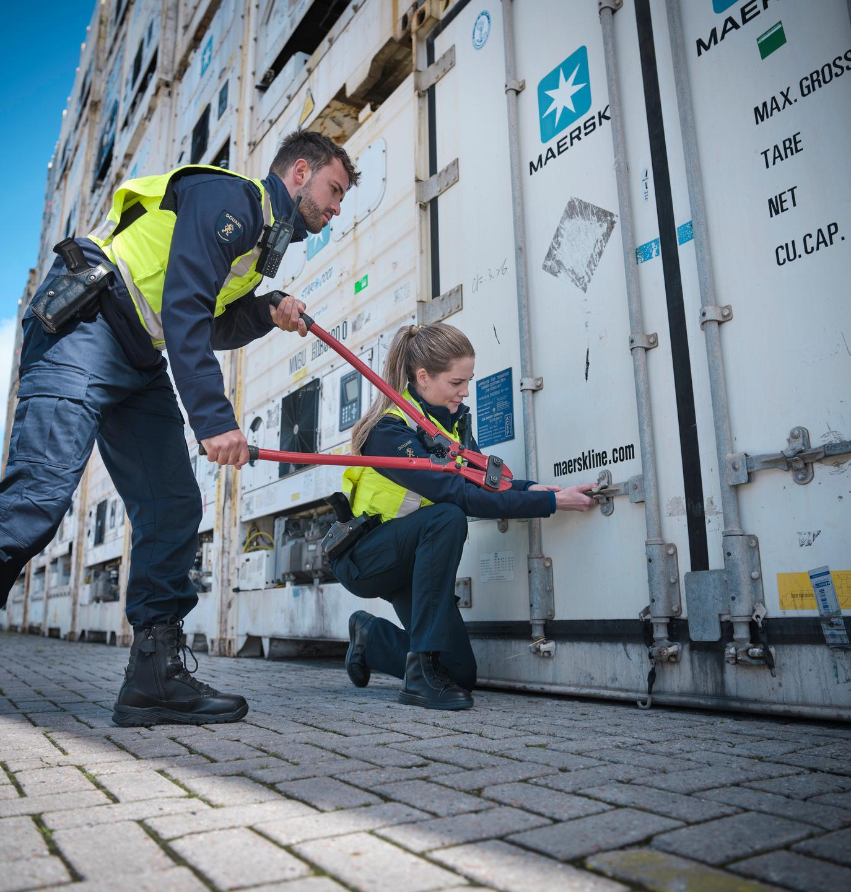
Takeaway messages
If we could ask you take away anything from our presentation today it would be…
Some MS are significantly behind schedule with CCI which is having an adverse affect on our future roadmap. We have ambitious growth plans and would like the ability to use CCI for all of our EU destinations.
Member states need to make CCI as facilitative as possible, as AEO is required to use it there should be more benefits associated with it eg Presentation waivers, self assessment etc.
The Customs Data Hub and Trust and Check are good initiatives however we cannot be confident they will be delivered on time if CCI is not properly implemented.
We see many cases of divergence between member states currently, consistent alignment is required to make CCI and the future datahub/trust and check viable.

Slide 12
Thank You
Ronnie Bennett
Global Head of Customs
rbennett@primark.co.uk
Mike Alexander
Customs Operations Manager – Europe
malexander@primark.co.uk

